Slide 1
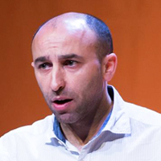
Sandro Pereira
Microsoft Azure MVP
BizTalk Server Fast & Loud Part II: Optimizing BizTalk

Slide 2

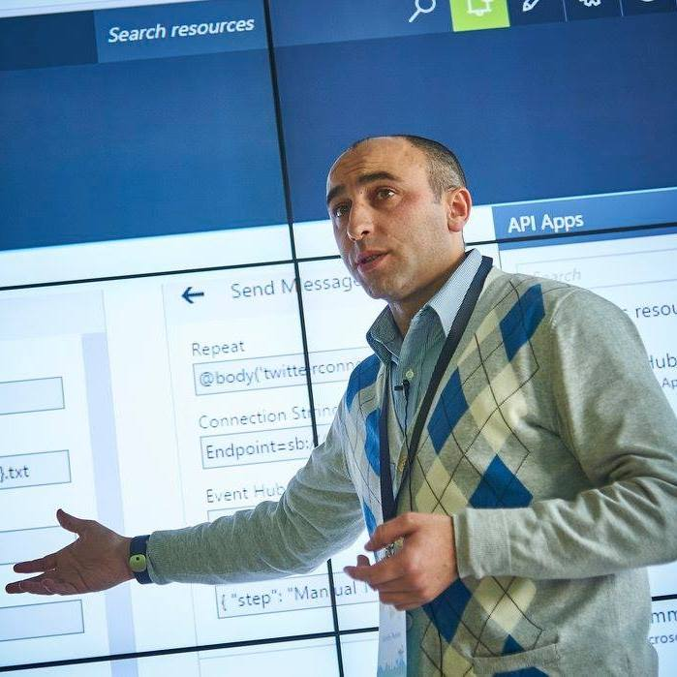


Who am I?
Codeless Wizard
Microsoft Azure MVP
Training, assessments and advising
Public speaker
Book author: “BizTalk Mapping Patterns and Best Practices”
sandro.pereira@devscope.net
linkedin.com/in/sandropereira
@sandro_asp
https://blog.sandro-pereira.com/
Sandro Pereira
Notes:
Interested in all things integration – which of course includes MS Flow

Slide 3


…and Loud Part II
Fast…

Slide 4

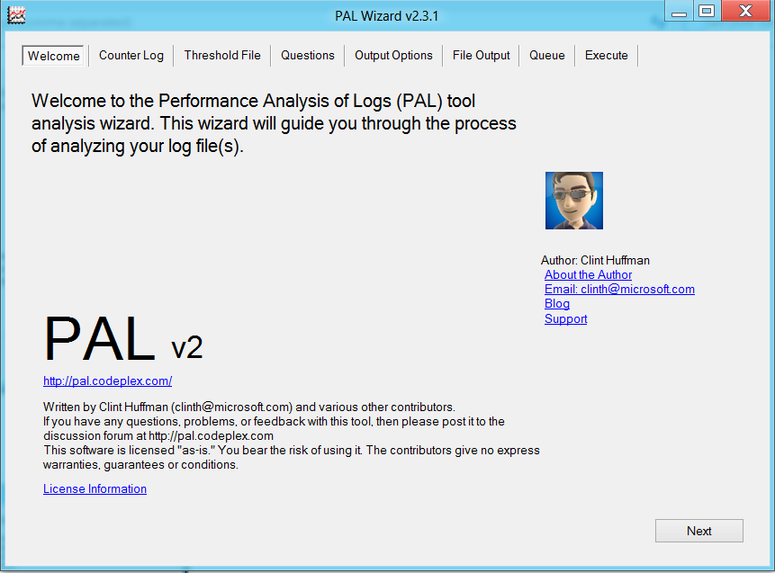
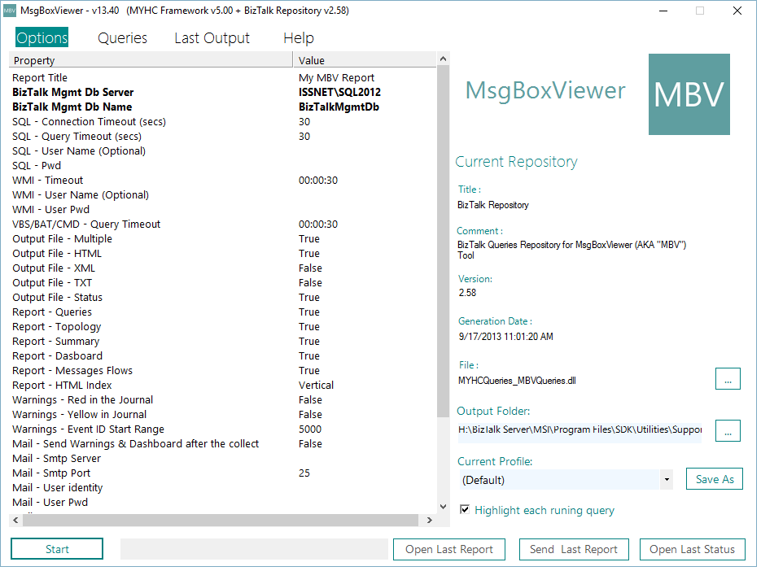
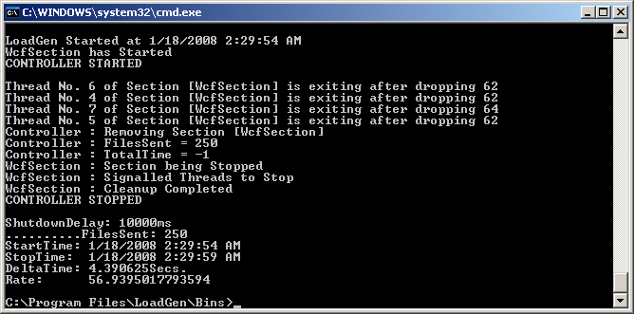
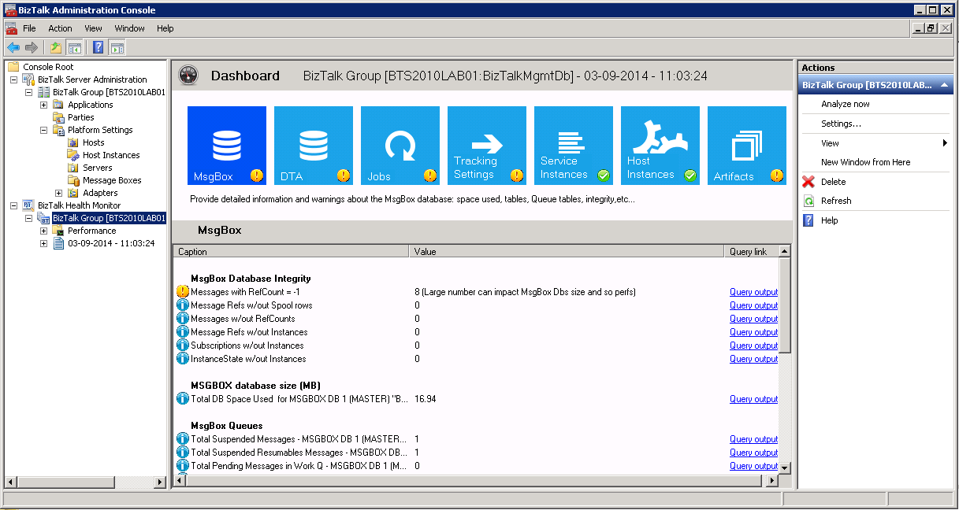
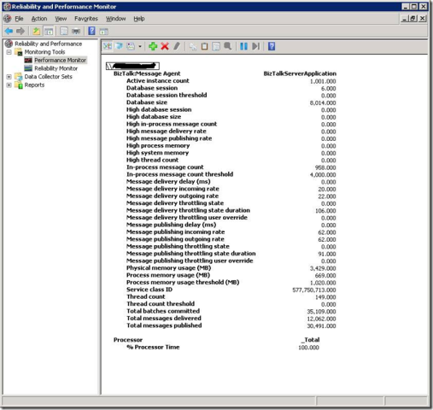
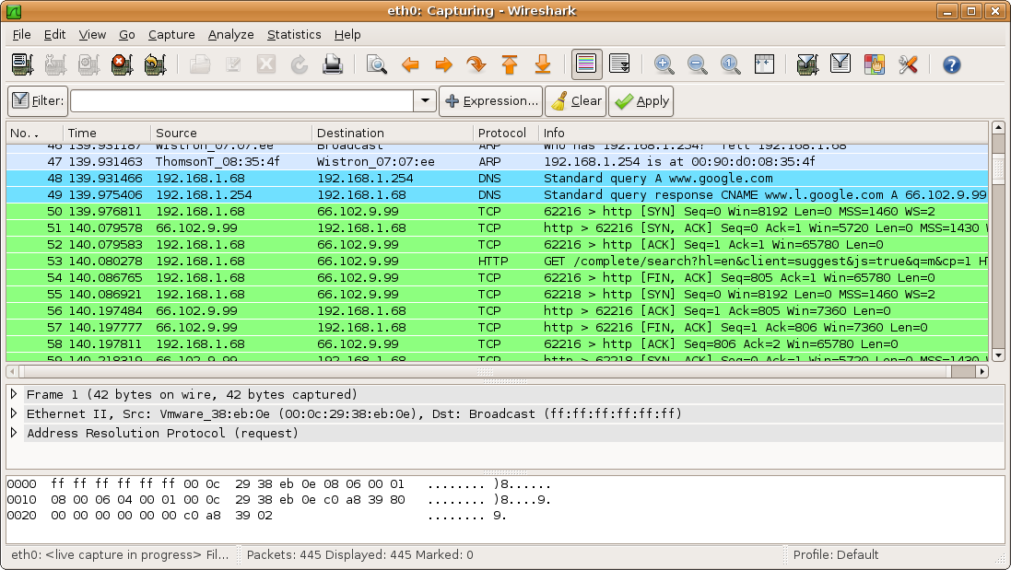
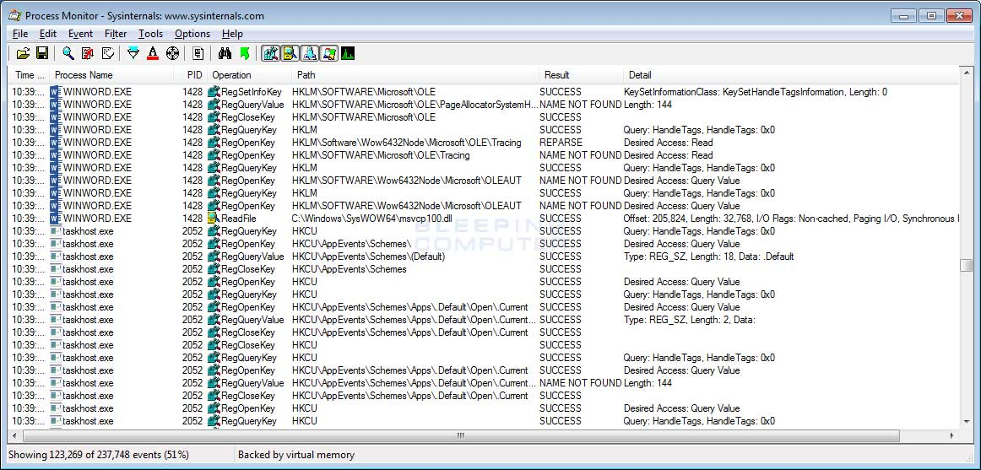
performance
issues…
@sandro_asp
Notes:
Performance Monitor
PAL
LoadGen
MsgBox Viewer
Health Monitor
WireShark
ProcMon

Slide 5
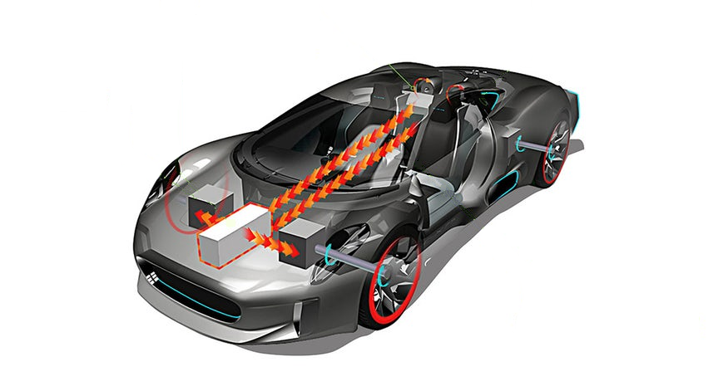
Memory
CPU
Battery
Fuel Injector
Car chassis
Exhaust pipe
BizTalk Server
Network
Virtualization layer
Hard drivers
Engine
Tiers
SQL Server
@sandro_asp

Slide 6


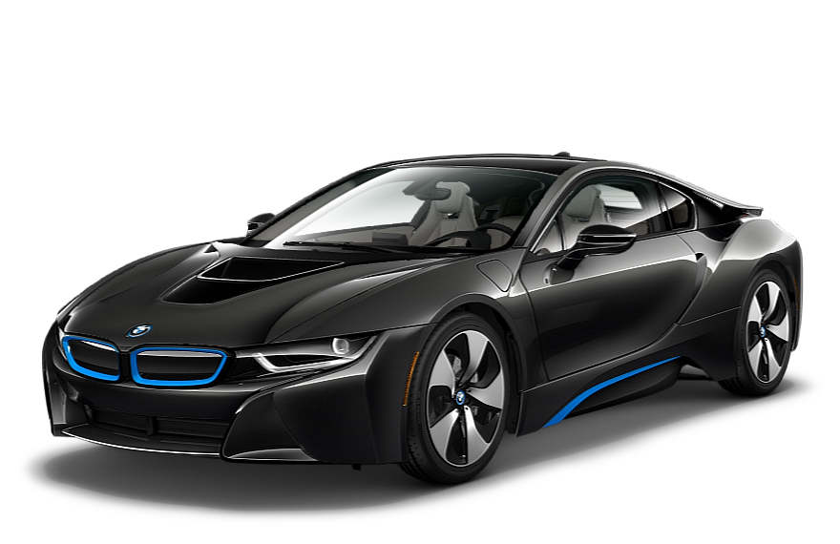


BizTalk Server can be…
@sandro_asp

Slide 7
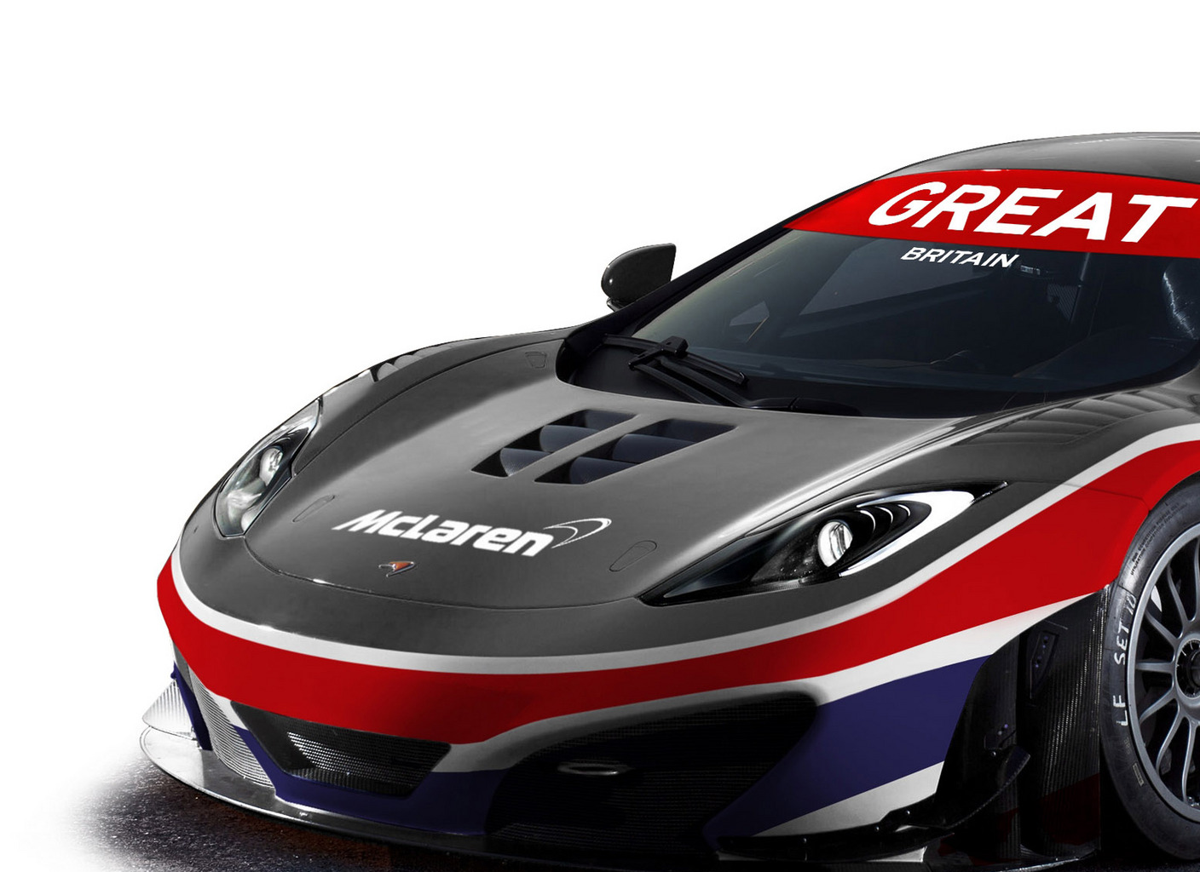
what is your requirements?
Process High-volume of messages?
Small volume but low latency is required?
Both…
what do you want
to archive?
@sandro_asp

Slide 8
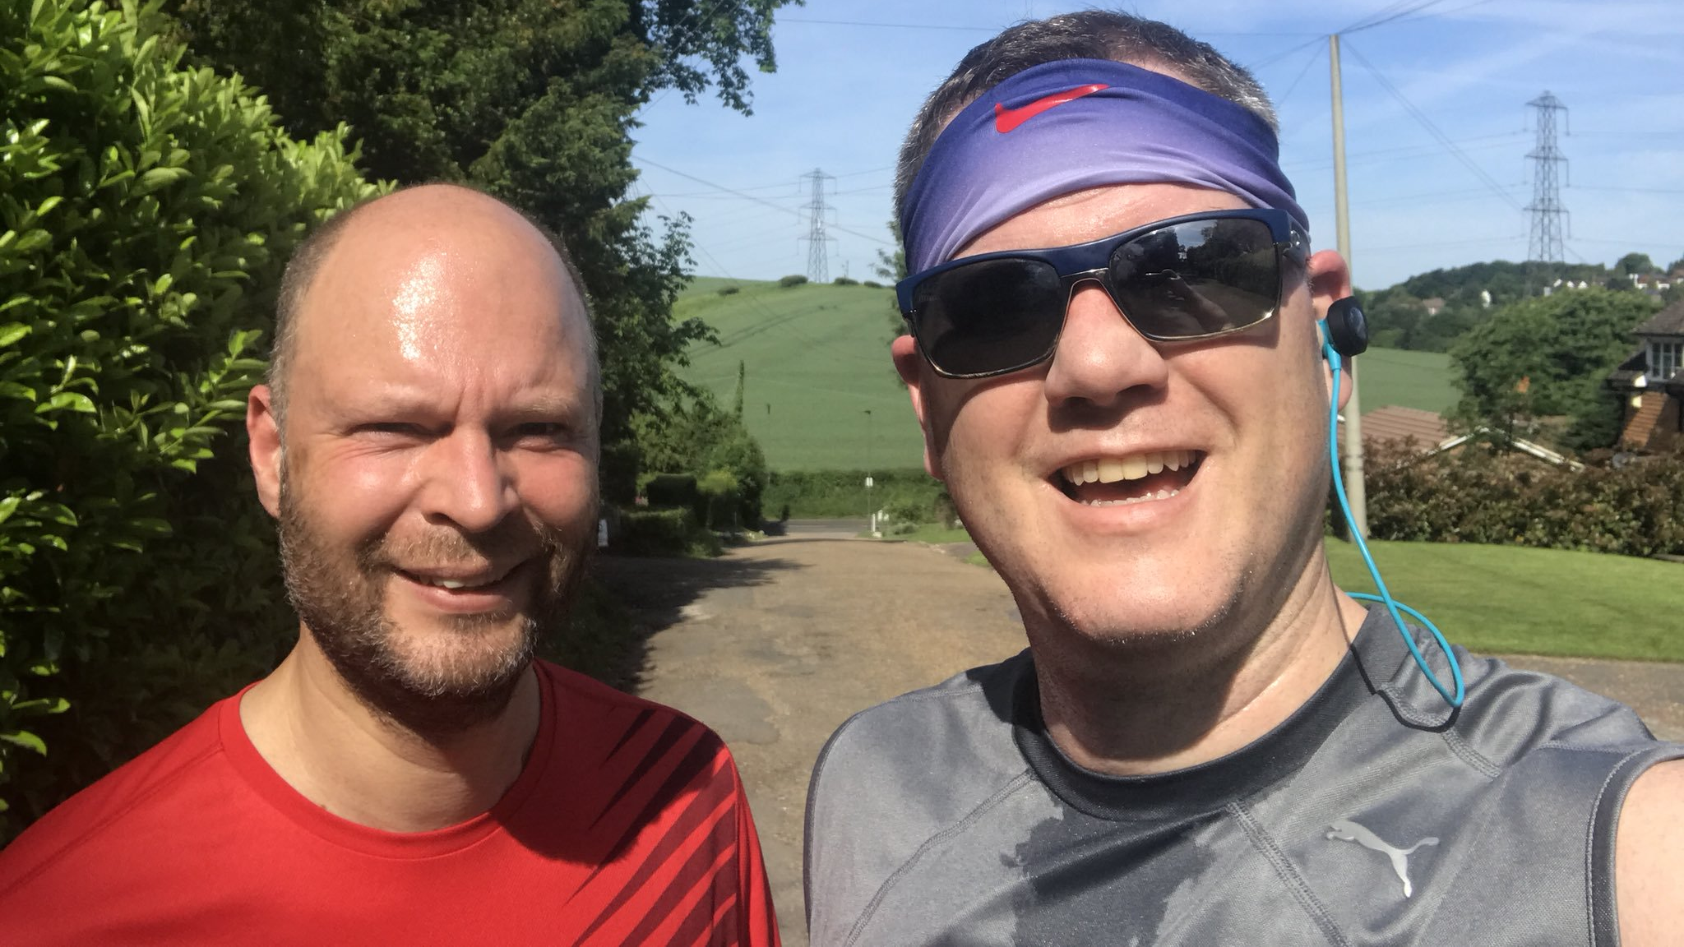
slowdown may not be an issue…
@sandro_asp

Slide 9

there isn’t any magic
solution…
@sandro_asp

Slide 10
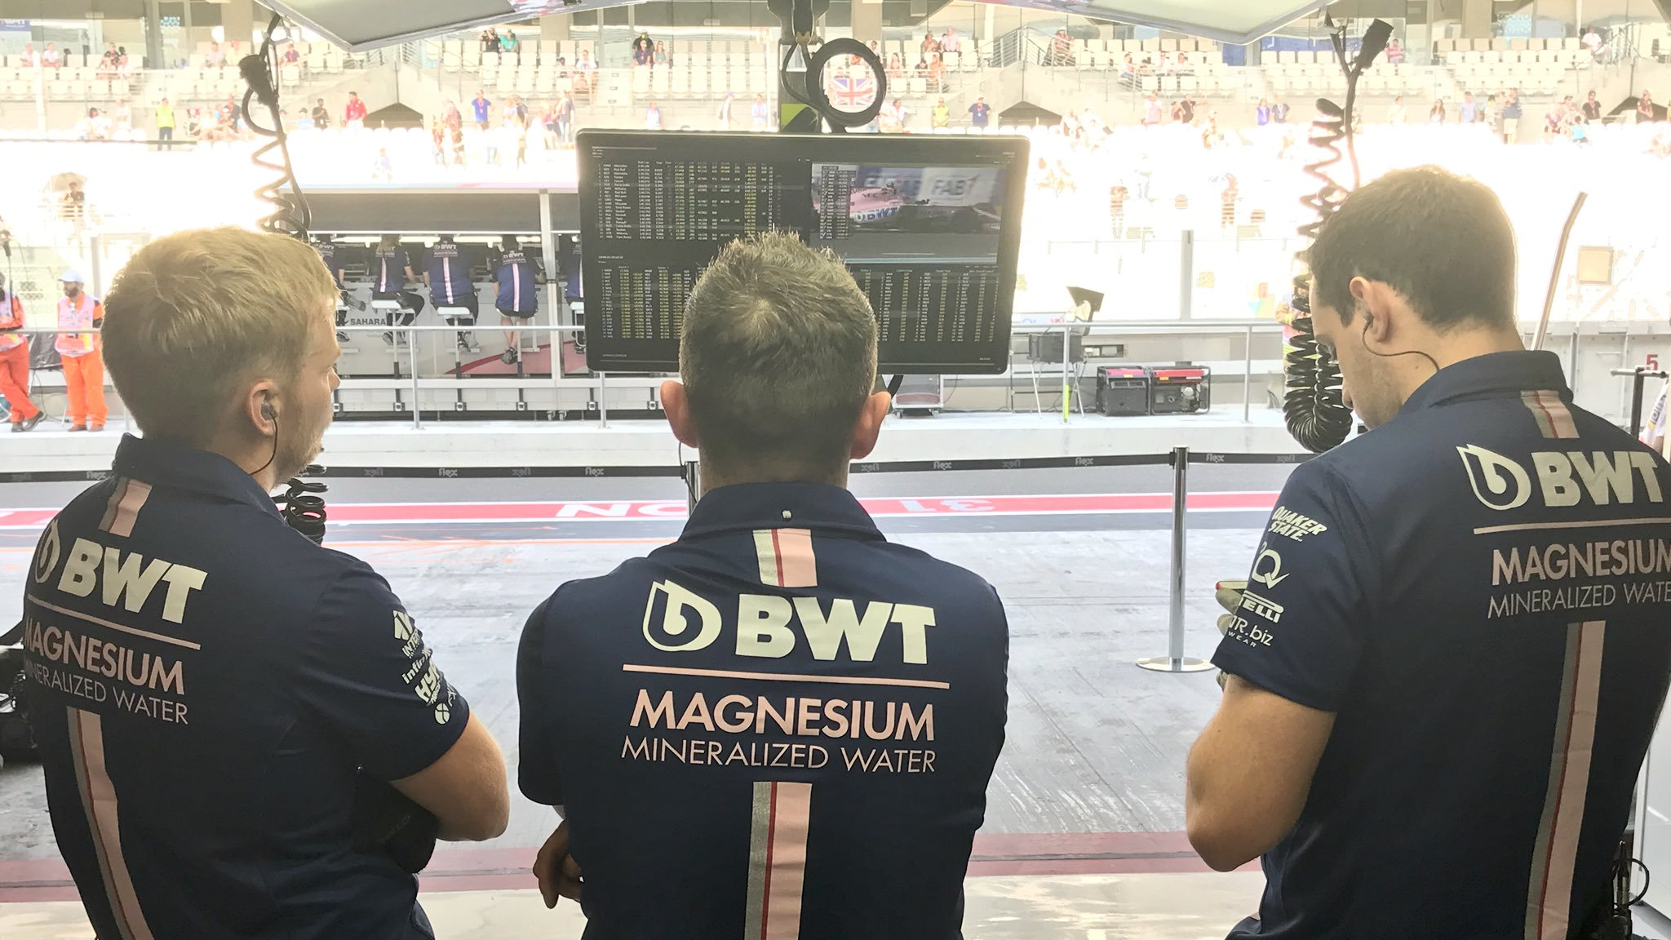
observation…
@sandro_asp

Slide 11
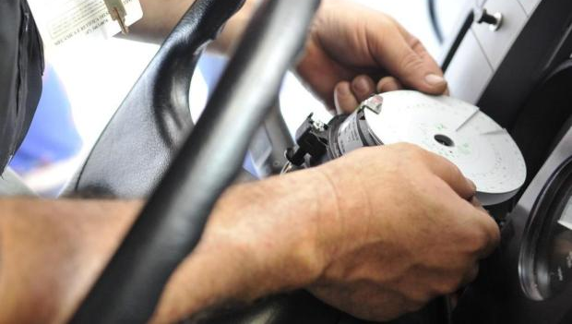
analysis…
investigate the causes…
@sandro_asp

Slide 12

apply fixes,
testing and wait
for results…
@sandro_asp

Slide 13
observation…
@sandro_asp

Slide 14
analysis…
investigate the causes…
@sandro_asp

Slide 15
apply fixes,
testing and wait
for results…
@sandro_asp

Slide 16

and sometimes…
be creative….
@sandro_asp

Slide 17
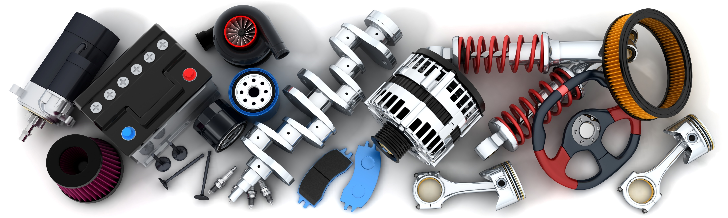
redesign the solutions
scaling (up or out )
tuning and optimization
@sandro_asp

Slide 18

surrounding systems
or layers…
@sandro_asp

Slide 19

not be addressed…
BizTalk Jobs running! or about BizTalk Server default installation…
… BizTalk Server SQL Server Agent jobs configured and running…
… large databases impact performance …
… different hard (logical) disk for data files, transaction log files, and for tempdb…
… splitting tempdb or MessageBoxBD in multiple files
… types of hard drives: SSD, HDD or RAID configurations (0,1 , 5, 10)…
… free disk space…
… networks bandwidth and efficiency or remove unnecessary network protocols…
…disable unnecessary services…
…number and isolation of host instances
@sandro_asp

Slide 20
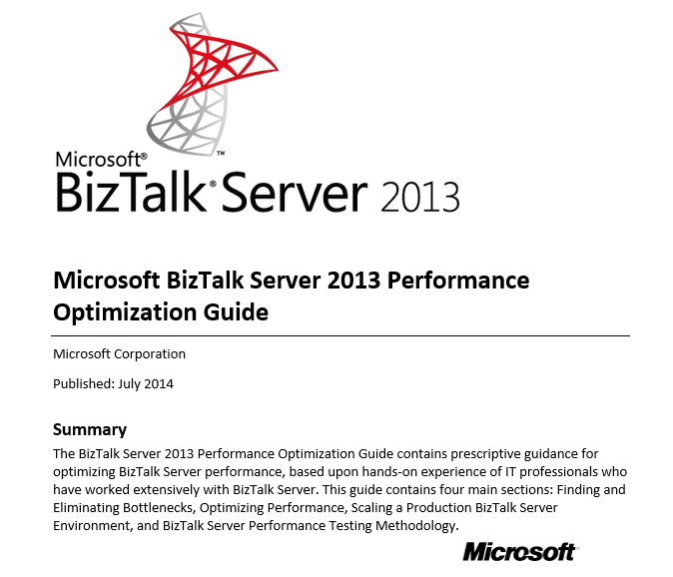
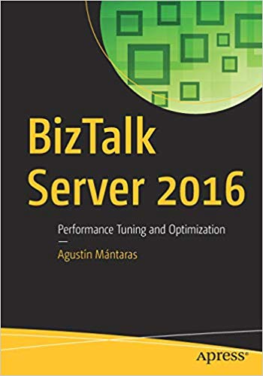
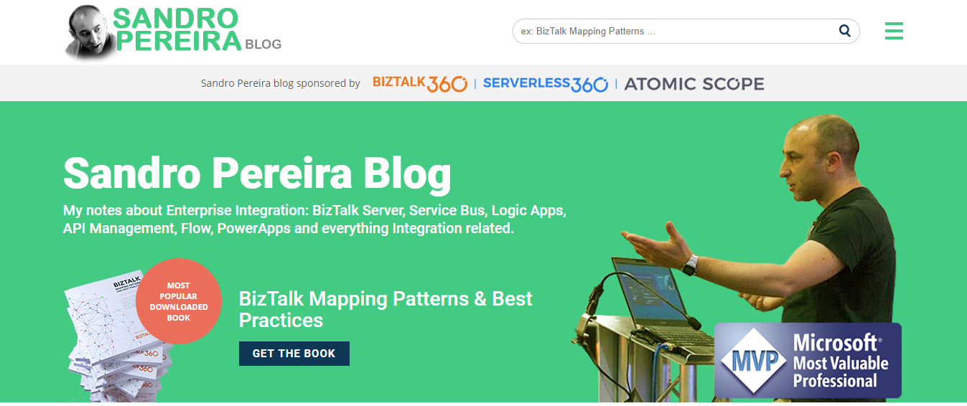
amazing resources…
@sandro_asp

Slide 21










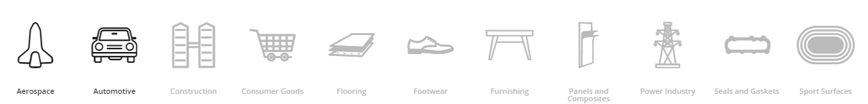
Corticeira Amorim
Cork Sector World Leader
@sandro_asp

Slide 22

scaling the solution
5.706.929
items processed
first month
STAGING DB
QUEUES
BizTalk Server
2016
SAP PI / SAP
ETL
TAKING TO MUCH
TIME TO PROCESS
secs → mins
One issue will affect both
Business Units
BU with less throughput
was being affect by the other
One issue will affect both
Business Units
@sandro_asp

Slide 23
redesign solution for scaling
ETL
STAGING DB
QUEUES
BizTalk Server
2016
SAP PI / SAP
ETL
2 SQL INSTANCES
CPU (4 VC) 90%
32 RAM 90%
Deadlock
Timeouts
411.680
msg first month
Deadlock
@sandro_asp

Slide 24

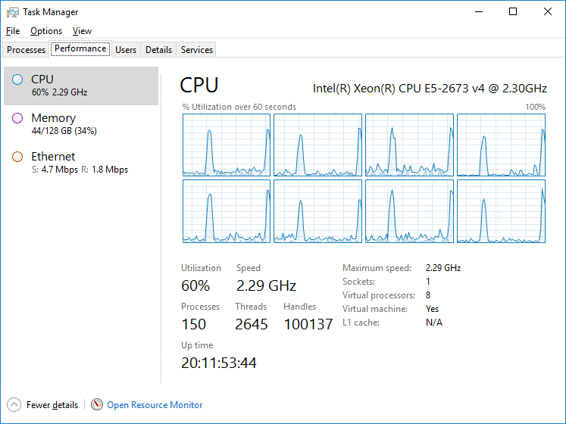

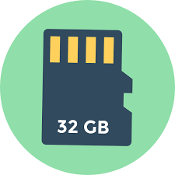
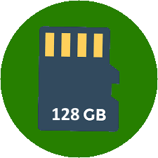
scaling up the SQL Server tier
@sandro_asp

Slide 25
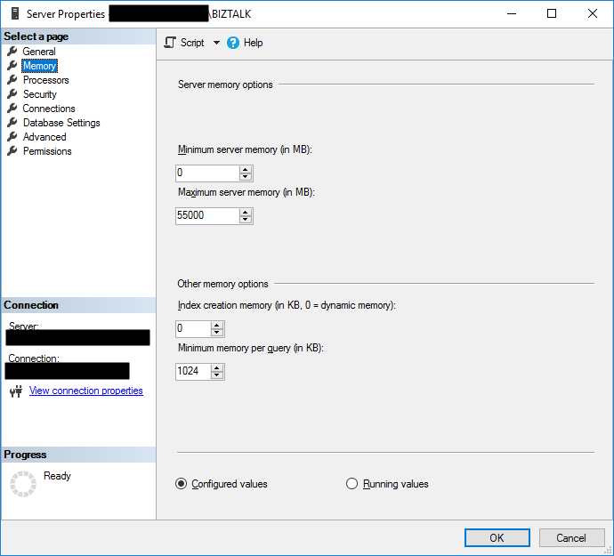
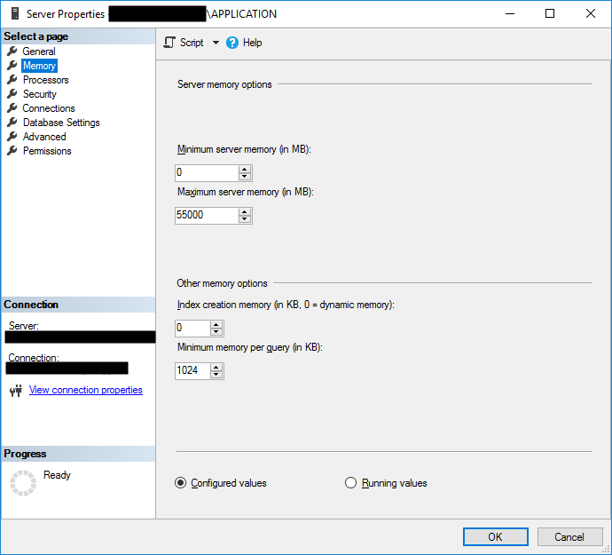
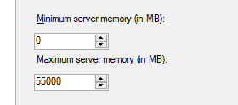
fixed amount of memory for SQL Server
@sandro_asp

Slide 26
Move data to HISTORIC
STAGING DB
QUEUES
BizTalk Server
2016
HISTORIC BD
TRACKING/MONITORING
SAP PI / SAP
MOVING DATA TO
HISTORIC TABLES
CLEANING THE
QUEUE TABLES
1M RECORDS
QUEUE TABLES
TAKING TO MUCH
TO PULL DATA
@sandro_asp

Slide 27
archiving average 3 secs
@sandro_asp

Slide 28

WARNING
The following show features stunts performed either by professionals
or under the supervision of professionals.
Accordingly, speaker and producers must insist that no one attempt
to recreate or re-enact any stunt or activity performed on this session
As they are dangerous and could lead to serious injuries.
Complains submissions of any kind are not accepted by
The presenter of this session!
@sandro_asp

Slide 29

opening a bank account
BizTalk Server 2016
BizTalk Server 2016
MQAgent
ATOMIC
ORCHESTRATIONS
COMPOSIT
ORCHESTRATIONS
1 min 30 secs
→ 3 secs
@sandro_asp

Slide 30
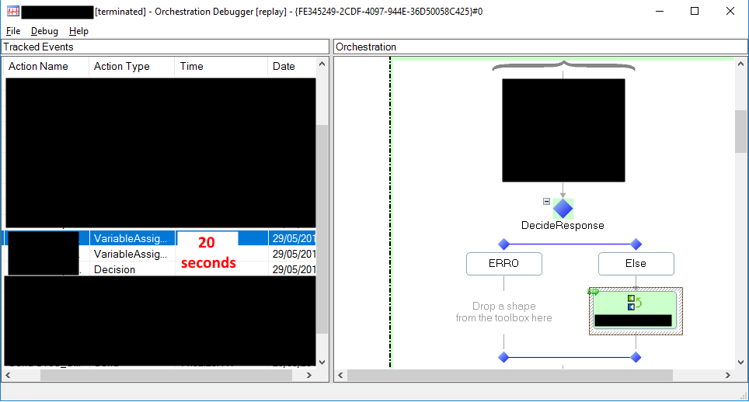
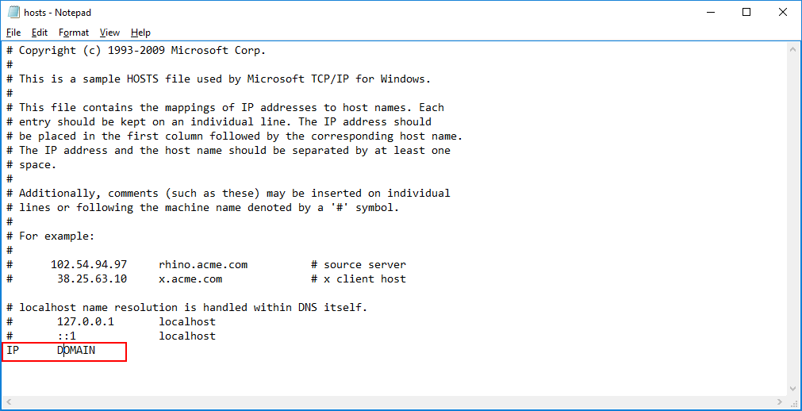
Network/LDAP issues
Expression shape is calling an
external http(s) service
telnet domain 389 (LDAP default port)
respond in 20 secs
20secs
→ >1 sec
@sandro_asp

Slide 31
Resources unload (slow first hit)
Action | Transaction | Time | Time progression
Request to APIM | Open Account | 12:22:11,917 | 00:00:00,000
APIM to BTS | Open Account | 12:22:11,937 | 00:00:00,020
BTS Orq Start | Open Account | 12:22:31,477 | 00:00:19,560
BTS | Open Account Internal | 12:22:31,633 | 00:00:19,716
BTS TO ATOMIC 1 | Open Account Internal | 12:22:32,330 | 00:00:20,413
BTS Orq ATOMIC Start | ATOMIC 1 | 12:22:52,003 | 00:00:40,086
BTS Orq ATOMIC SEND TO MQ Start | ATOMIC 1 | 12:22:52,647 | 00:00:40,730
BTS Orq ATOMIC SEND TO MQ END | ATOMIC 1 | 12:22:54,870 | 00:00:42,953
BTS Orq ATOMIC RCV FROM MQ | ATOMIC 1 | 12:22:56,573 | 00:00:44,656
BTS TO ATOMIC 1 END | ATOMIC 1 | 12:22:56,887 | 00:00:44,970
RCV Account Internal | Open Account Internal | 12:22:57,600 | 00:00:45,683
…. | … | … | ..
Response from APIM | Open Account | 12:23:31,993 | 00:01:20,076
BizTalk Server 2016
BizTalk Server 2016
MQAgent
ATOMIC
ORCHESTRATIONS
COMPOSIT
ORCHESTRATIONS
BizTalk Server warm up
IIS warm up
COM+ component warm up
@sandro_asp

Slide 32
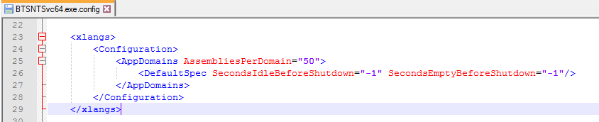
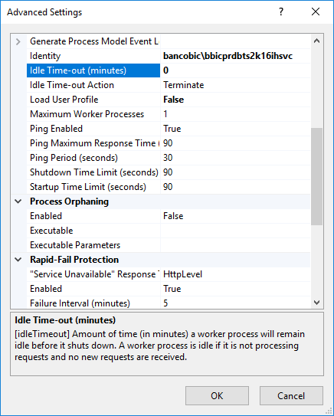
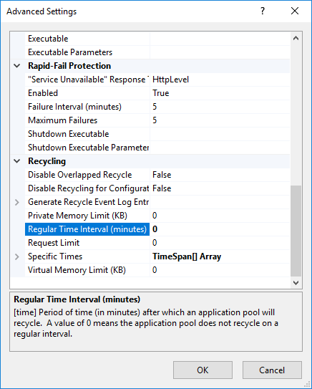
Recycling BizTalk and IIS
@sandro_asp

Slide 33
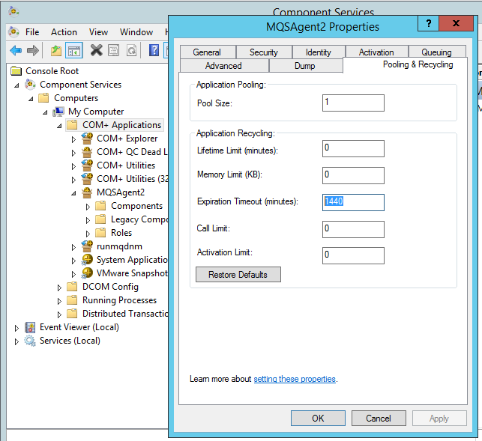
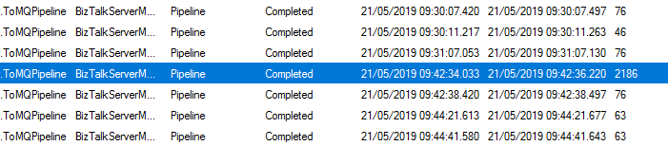
MQAgent Recycling
from losing 2 secs each
15 min of inactivity
to an average of 60 ms
@sandro_asp

Slide 34
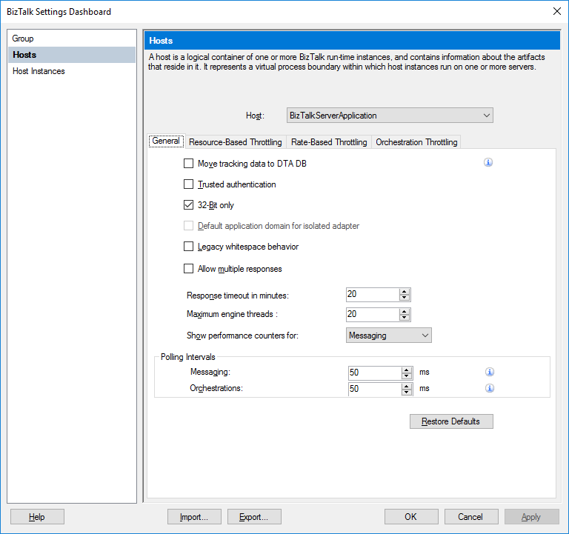
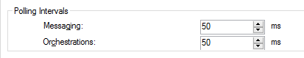
BizTalk Polling Intervals
BizTalk Server 2016
ATOMIC
ORCHESTRATIONS
500 ms
500 ms
COMPOSIT
ORCHESTRATIONS
500 ms
500 ms
500 ms
500 ms
500 ms
500 ms
500 ms
500 ms
500 ms
500 ms
@sandro_asp

Slide 35
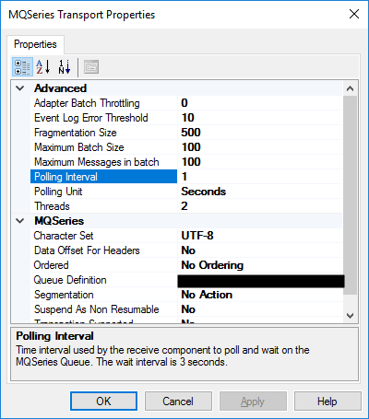
MQSeries Polling Intervals
BizTalk Server 2016
ATOMIC
ORCHESTRATIONS
5 segs
COMPOSIT
ORCHESTRATIONS
5 segs
5 segs
@sandro_asp

Slide 36
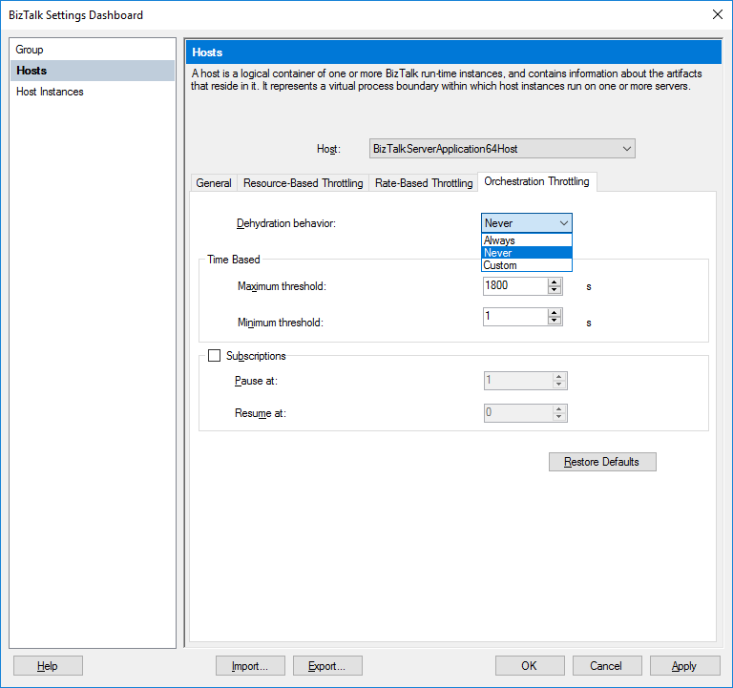
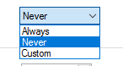
Orchestration Dehydration
BizTalk Server 2016
ATOMIC
ORCHESTRATIONS
COMPOSIT
ORCHESTRATIONS
@sandro_asp

Slide 37
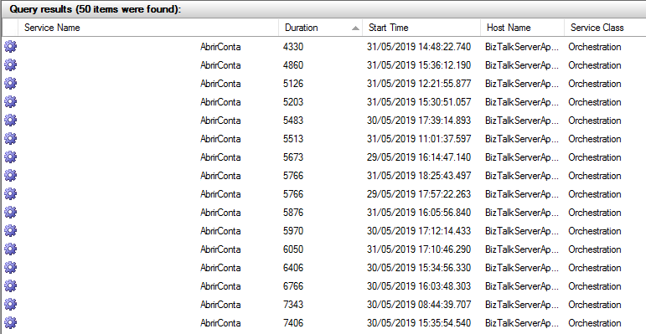
and the result…
4330 → 4.3 seconds
4860 → 4.8 seconds
5126 → 5.1 seconds
32970 → 32,9 seconds
(first request)
@sandro_asp

Slide 38
disable anti-virus or add exclusion rules…
… reduce to a minimum tracking…
… number simultaneous HTTP connections…
… SQL process affinity…
… priority in send ports…
orchestrations also
@sandro_asp

Slide 39

serverless baby…
no servers for me!
@sandro_asp

Slide 40
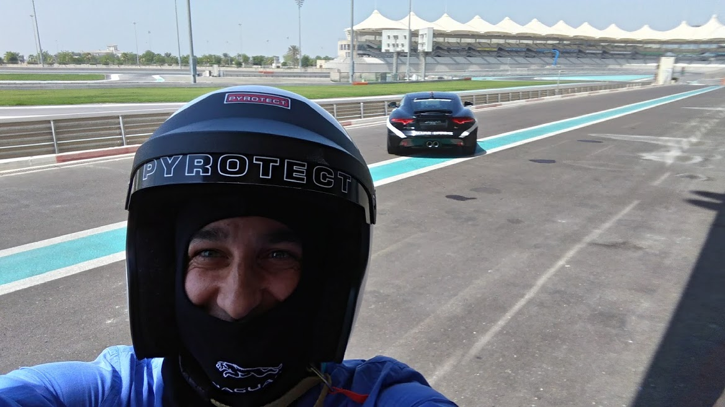
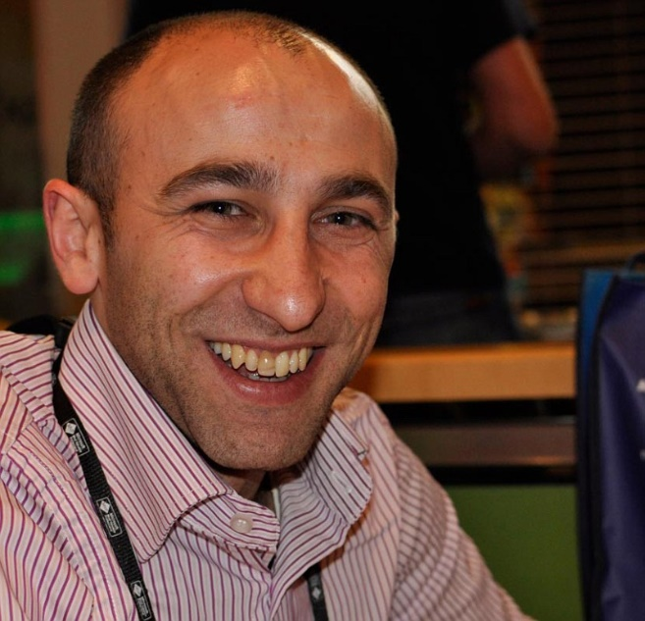



thanks…
Sandro Pereira
Integration Codeless Wizard | Microsoft Azure MVP
sandro.pereira@devscope.net
linkedin.com/in/sandropereira
@sandro_asp
blog.sandro-pereira.com/
+351 223 751 350
www.devscope.net

